Slide 1
Lecture 4: PaaS Programming Model
K. V. Subramaniam

Slide 2
Motivational Exercise 1 (10 mins)
Consider building a photosharing app
User uploads photo
App recognizes faces in photo
App stores photos + faces in photo into database.
What will you do in various tiers of the 3-tier application model?
What are the steps to get it working on a IaaS cloud?

Slide 3
Motivational Exercise 1: Solution
Upload photo
Start a VM
Connect a block storage device
Install Web Server
Install App Server
Install Database
Upload application
Run Application
Front End
GUI
App Logic
Store Photo
Recognize face
Photo
Faces in photo
Database

Slide 4
Exercise - PaaS Programming Model (5 mins)
Upload photo
If mundane tasks like installing web and database servers are taken care of by PaaS,
Then
Do we just upload the application to the cloud controller?
What are the challenges?
GUI
Front End
App Logic
Store Photo
Recognize face
Photo
Faces in photo
Database

Slide 5
Exercise - PaaS Programming Model (5 mins)
Upload photo
If mundane tasks like installing web and database servers are taken care of by PaaS,
Then
Do we just upload the application to the cloud controller?
How does the PaaS platform know which parts do deploy where (e.g., some components may need to run under a web server)?
GUI
Front End
App Logic
Store Photo
Recognize face
Photo
Faces in photo
Database

Slide 6
PaaS Programming Model – solution
Upload photo
Application
Made up of components
Each component specifies environment (e.g., run under web server or app server)
Specifies initial number of components, scale up / scale down policy
In Windows Azure
Web roles – front end type tasks
Worker roles – those that run tasks in the background (Different colours on the figure)
PaaS Layer
Deploy
Allocate resources
Number of instances
Front End
GUI
PaaS Layer
App Logic
Store Photo
Recognize face
Photo
Faces in photo
Database

Slide 7
Introduction
Application
How do we build a PaaS?
What do we want to do?
User pushes into cloud
Application
Specification of S/W (e.g., OS, Web server)
Services needed from cloud (e.g., load balancing, db)
How can I do this?
Suppose I have an IaaS
Then I need a cloud controller that will automatically create VMs, etc. for the user
App
Software Image
Services
PaaS Layer
Cloud Controller
Cloud
IaaS

Slide 8
Common Layered PaaS Architecture
Cloud controller
Automatically creates VMs and containers
Deploys applications
Connects to services
Automatically scales up or down
Storage Services
Object
NoSQL
Relational
Block storage
Applications store state in Storage Services
Simpler to scale applications
Easier recovery from failure
IaaS
Cloud Controller
VMs / Containers
Storage Services

Slide 9
Review
How can we build PaaS on top of IaaS
PaaS layer needed
Create VMs or containers needed
Deploy application
Connect to cloud services

Slide 10
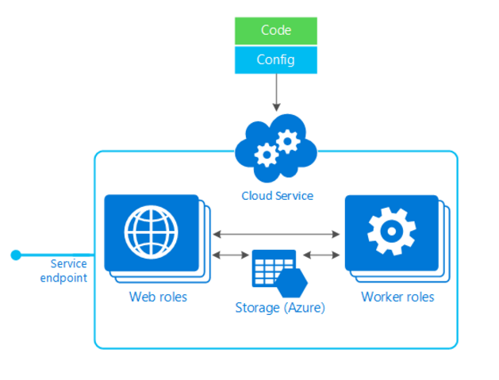
Windows Azure Application Architecture
Compute: Processes
Communication: Message Queues
Guaranteed delivery eventually
Even if receiver or network is down now
Storage
Db services
Blob services
Other services may exist
Storage
--SQL
--NoSQL
--Blob

Slide 11
Windows Azure Processes
Web role
Accepts HTTP and HTTPS requests
Runs under IIS (Microsoft Web Server)
Intended to be used as front-end for application
Worker role
.Net process
Intended to be used as back-end for application
Why are worker roles needed?

Slide 12
Why Use Worker Roles
Example
Suppose a db query is to be made by app
Why not do this in web role?
Worker role
Intended to be used for long-running or asynchronous operations
Not good to have long running operations executed synchronously in Web role
Timeouts
Application appears to hang, user may cancel

Slide 13
Azure Load Balancing - 1
In reality, we would have Multiple Web role processes
Need a load balancer
What are the requirements for a load balancer?

Slide 14
Azure Load Balancing – 2 – Requirements
Distribute load among all the Web roles
Aware of scale up
Aware of scale down
Service monitoring - Probe types
Guest agent: call some API in Web role
HTTP
TCP
Both host and port selection

Slide 15
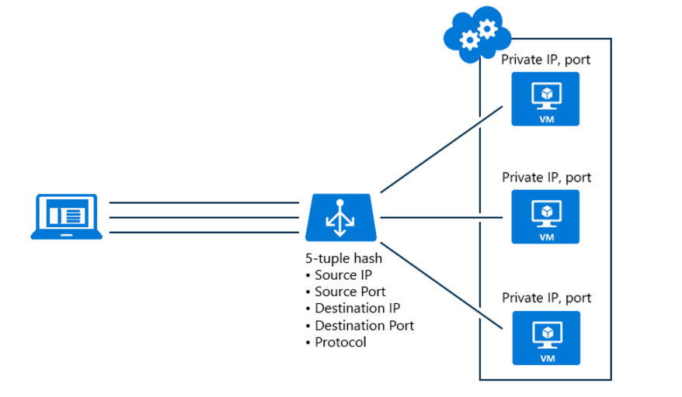
Azure Load Balancing – 3 Hash Based distribution
Stickiness within a single TCP session
Public Endpoints
Which listen to external requests.

Slide 16
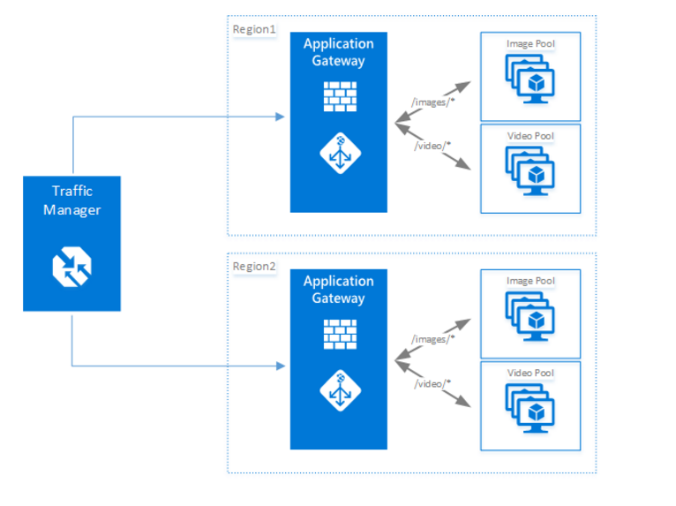
Azure Load Balancing – 4
Application Gateway
Round-robin load balancing of HTTP(S)
Can be used to load balance internal requests also
Traffic Manager
Make DNS request
Get IP address of one of the gateways
Connect to gateway

Slide 17
Azure Storage: Blob service
Allows storage and retrieval of binary or text data (files?)
Two types of blobs
Page blobs: optimized for random access
Block blobs: optimized for sequential access
Blobs are stored in containers
http://myaccount.blob.core.windows.net/container
http://myaccount.blob.core.windows.net is the root container
Container names can have the ‘/’ character
Blobs can have associated metadata (key-value pairs)

Slide 18
Azure Storage: Table Service
Partition
Key
Row
Key
NoSQL database
Tables indexed by a key
Key has two parts
Partition key
Row key
Table is partitioned on partition key
Rows with the same partition key are stored in the same partition
Row key identifies row in a partition
<Partition key, row key> together uniquely identify a row
Selects row in partition
3 partitions
Determines which partition to put tuple

Slide 19
SQL Azure
Relational database service
Based on SQL Server
Use .Net APIs in the same way that they would be used in a non-cloud application

Slide 20
Assignment/Video
Google, The Cloud and the Future of Computing
https://www.youtube.com/watch?v=jUs3qtbbPV0

